Slide 1

Notes:
Cover Slide

Slide 2


RATIOS, PROPORTIONS AND VARIATIONS
Notes:
This is the template for slides with an image and a bullet list

Slide 3
VARIATIONS:
Variation deals with how one quantity changes with respect to one or more other quantities.
Two quantities are said to vary with each other, if there exists a relationship between them such that a change is ‘A’ entails a change in ‘B’ and vice-versa.
There are two types of variation: direct variation and inverse variation.
Notes:
Webinar Cover

Slide 4
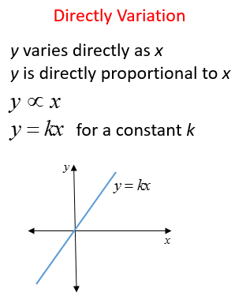
DIRECT VARIATIONS:
If Quantity 1 varies directly with Quantity 2; i.e. Quantity 2 increases if Quantity 1 increases and Quantity 2 decreases if Quantity 1 decreases;
then they are said to be in direct variation. For example, if Time is constant, the Speed will be directly proportional to the distance. That is, if the Speed is more, then the distance covered will also be more, and vice-versa Speed α Distance
.
Notes:
Webinar Cover

Slide 5
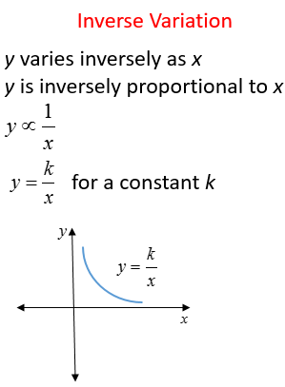
INDIRECT VARIATIONS:
If Quantity 1 varies inversely with Quantity 2, then they are said to be in inverse variation. For example, Speed varies inversely with time; that is if the Speed is more, then the time taken to cover a constant distance will be less. This means that when speed is minimum, then time is maximum; and when speed is maximum, then time is minimum.
.
Notes:
Webinar Cover

Slide 6
FORMULA:
If u/v = x/y, then uy = vx
If u/v = x/y, then u/x = v/y
If u/v = x/y, then v/u = y/x
If u/v = x/y, then (u+v)/v = (x+y)/y
If u/v = x/y, then (u-v)/v = (x-y)/y
If u/v = x/y, then (u+v)/ (u-v) = (x+y)/(x-y), which is known as componendo -Dividendo Rule
If u/v = v/x, then u/x = u²/v²
If u/v = x/y, then u = x and v =y
If a/(b+c) = b/(c+a) = c/(a+b) and a+b+ c ≠0, then a =b = c
Notes:
This is the template for slides with only a bullet list

Slide 7
Question: 01
A policeman starts to chase a thief and moves 8 steps when the thief takes 10 steps, but 7 steps of the thief equals 5 steps of the policeman. The ratio of the speeds of the policeman and the thief is,
25 : 28
26 : 25
25 : 26
28 : 25
Answer: D
Notes:
This is the template for slides with only a bullet list

Slide 8
SOLUTION:
By first statement in same length of time ratio of the distance covered by the two, which is the ratio of speeds of the two is,
8P/10T=4P/5Twhere P is the step length of the policeman and T is the step length of the thief.
Again by the second statement,
7T=5P
P/T=7/5
Putting this in speed ratio relation we have the ratio of speeds as,
4P/5T=28/25
Notes:
This is the template for slides with only a bullet list

Slide 9
Question: 02
A trader sells 20 kg of sugar at Rs. 400 and agrees to the request of a customer to give him a discount of 20%. But being a dishonest trader he uses a spurious weight which is less by 4% per kg of weight. The effective discount that the customer then gets,
15.5%
16%
16.66%
19.6%
Answer: C
Notes:
This is the template for slides with only a bullet list

Slide 10
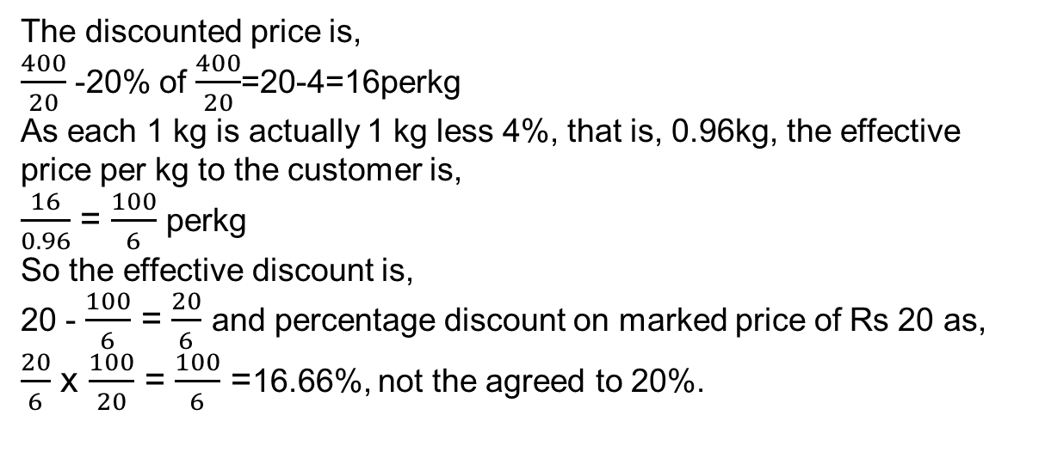
SOLUTION:
The discounted price is,
$\frac{400}{20}$ -20% of $\frac{400}{20}$=20-4=16perkg
As each 1 kg is actually 1 kg less 4%, that is, 0.96kg, the effective
price per kg to the customer is,
$\frac{16}{0.96}$ = $\frac{100}{6}$ perkg
So the effective discount is,
20 - $\frac{100}{6}$ = $\frac{20}{6}$ and percentage discount on marked price of Rs 20 as,
$\frac{20}{6}$ x $\frac{100}{20}$ = $\frac{100}{6}$ =16.66%, not the agreed to 20%.
Notes:
This is the template for slides with only a bullet list

Slide 11
Question: 03
A certain amount of money is divided among A, B and C. If A receives 25% more than B and B receives 25% less than C, then A : B : C is,
12 : 10 : 11
10 : 9 : 12
15 : 12 : 16
14 : 12 : 13
Answer: C
Notes:
This is the template for slides with only a bullet list

Slide 12
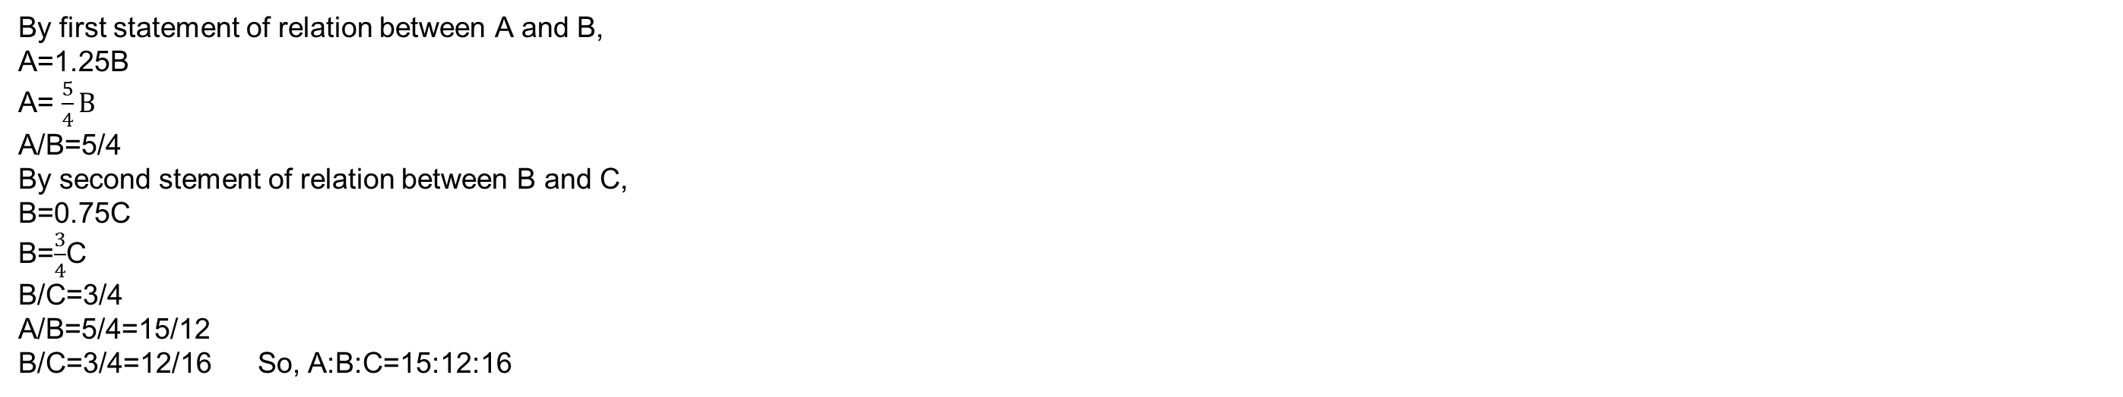
SOLUTION:
By first statement of relation between A and B,
A=1.25B
A= $\frac{5}{4}B$
A/B=5/4
By second stement of relation between B and C,
B=0.75C
B=$\frac{3}{4}$C
B/C=3/4
A/B=5/4=15/12
B/C=3/4=12/16 So, A:B:C=15:12:16
Notes:
This is the template for slides with only a bullet list

Slide 13
Question: 04
When A, B and C do a task together the ratio of work that A and B do together with respect to what C does is 7 : 3 and the ratio of work that B and C together do to the work A does is 1 : 1. Which worker among the three is most efficient?
B
A
C
Cannot be answered with the given information
Answer: B
Notes:
This is the template for slides with only a bullet list

Slide 14
SOLUTION:
Let A,B and C be the portion of work that A, B and C do per unit time
when they work together.
By the first statement then,
(A+B)/C=7/3
and by the second statement,
B+C=A
By adding 1 to both sides of the first equation we have, (A+B+C)/C=2A/C=10/3
Or A/C=5/3
Notes:
This is the template for slides with only a bullet list

Slide 15
Question: 05
If 40% of a number is equal to two-third of another number, what is the ratio of first number to the second number?
2:5
3:7
5:3
7:3
Answer: C
Notes:
This is the template for slides with only a bullet list

Slide 16
SOLUTION:
Let 40% of A =2/3B
Then,40A/100=2B/3
2A/5=2B/3
A/B=(2/3 X 5/2)=5/3
A:B=5:3
Notes:
This is the template for slides with only a bullet list

Slide 17
Question: 06
Two number are in the ratio 3 : 5. If 9 is subtracted from each, the new numbers are in the ratio 12 : 23. The smaller number is:
27
33
49
55
Answer: B
Notes:
This is the template for slides with only a bullet list

Slide 18
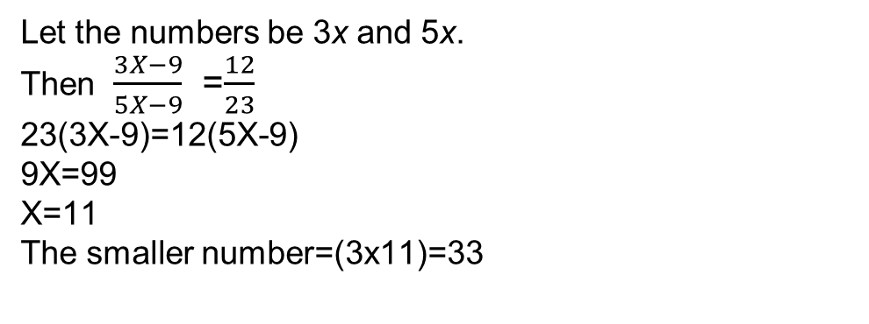
SOLUTION:
Let the numbers be 3x and 5x.
Then $\frac{3X−9}{5X−9}$ =$\frac{12}{23}$
23(3X-9)=12(5X-9)
9X=99
X=11
The smaller number=(3x11)=33
.
Notes:
This is the template for slides with only a bullet list

Slide 19
Question: 07
Rajesh and Somesh were classmates. Their earnings now are in the ratio 5:6. The ratio of their expenses is 7:9. Somesh saves Rs. 3,000 every month while Rajesh saves Rs. 1000/- more than Somesh. Find the total earnings and expenses of each of them.
Rajesh - 25000, 21000; Somesh - 30000, 27000
Rajesh - 30000, 27000; Somesh - 36000, 32000
Rajesh - 36000, 32000; Somesh - 30000, 27000
None of the above
Answer: A
Notes:
This is the template for slides with only a bullet list

Slide 20

SOLUTION:
Income ratio = Rajesh : Somesh = 5:6 =5/6
Common factor helps in finding actual values easily So, take 'A' as common factor. Income of Rajesh = 5A; Income of Somesh = 6A
.
Since Rajesh save, Rs 1000/- more than Somesh, Rajesh's savings = Rs4000/-
(5A-4000)/(6A-3000)=7/9
9(5A-4000)=7(6A-3000) A=5000 Income of Rajesh = 5A = 25000 ; Income of Somesh = 6A = 30000 Spending of Rajesh =25000 - 4000 = 21000 ;Spending of Somesh = 30000 - 3000 = 27000
Notes:
This is the template for slides with only a bullet list

Slide 21
Question: 08
a:b = 3:4 and b:c = 9:7. What is a:b:c?
3 : 13 : 7
3 : 36 : 28
27 : 16 : 28
27 : 36 : 28
Answer: D
Notes:
This is the template for slides with only a bullet list

Slide 22
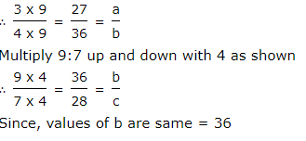
SOLUTION:
B is common to both the ratios. Values of b = 4 and 9 (That means they are not the same) Make the values of 'b' same as follows - Multiply 3:4 up and down with 9 as shown.
.
a : b : c = 27 : 36 : 28
Notes:
This is the template for slides with only a bullet list

Slide 23
Question: 09
A batch of students wants to gift a projector worth Rs 4,200 to their school. If the teachers, offer to pay 50% more than the students and an external benefactor gives three times the teacher's contribution, then how much should the teachers donate?
800
900
500
600
Answer: B
Notes:
This is the template for slides with only a bullet list

Slide 24
SOLUTION:
If student offer 100x, The ratio of student and teacher = 100x : 150x = 2 : 3 The ratio of teacher and benefactor = 100x : 300x = 1 : 3 The ratio of the share (students : teacher: benefactor) = 2 : 3 : 9 So the proportion to teacher's share = 3/14 Hence, the teachers would donate = (3*4200)/14 = Rs. 900
.
Notes:
This is the template for slides with only a bullet list

Slide 25
Question: 10
Peri gave 40% of the amount to Kavi. Kavi gave one-fourth of what he received from Peri to Adi. After paying Rs. 200 to the taxi driver out of the amount he got from Kavi, Adi is now left with Rs. 600. How much amount did Peri have?
16000
18000
8000
3000
Answer: C
Notes:
This is the template for slides with only a bullet list

Slide 26
SOLUTION:
Let Peri have Rs X, Then Kavi = 40% = 40X/100 = 2X/5 Adi = (2X/5)*(1/4) = X/10 According to question, X/10 - 200 = 600 X = Rs 8000
.
Notes:
This is the template for slides with only a bullet list

Slide 27
Question: 11
In a competitive exam, the number of passed students was four times the number of failed students. If there had been 35 fewer appeared students and 9 more had failed, the ratio of passed and failed students would have been 2 : 1, then the total number of students appeared for the exam ?
170
165
155
170
Answer: C
Notes:
This is the template for slides with only a bullet list

Slide 28
SOLUTION:
Let the number of failed students be x Number of passed students = 4x So total number of students was 5x From the given data If total number of students be 5x â€“ 35 (5x - 35) / (x + 9) = 3/1 5x - 35 = 3(x + 9) 5x - 35 = 3x + 27 x = 31 Total number = 31*5 = 155
.
Notes:
This is the template for slides with only a bullet list

Slide 29
Question: 12
A certain number is divided into two parts such that 5 times of the first part added to 11 time of the second part makes 7 time of the whole. The ratio of the first part to second part is:
2:1
4:5
1:2
5:11
Answer: A
Notes:
This is the template for slides with only a bullet list

Slide 30
SOLUTION:
Let the first and second part of the number be x and y respectively. Then, 5x + 11y = 7(x + y) ---> 5x + 11y = 7x + 7y ---> 11y - 7y = 7x - 5x ---> 4y = 2x ---> 2y = x ---> Ratio of the first part to second part = x : y = 2 : 1
.
Notes:
This is the template for slides with only a bullet list

Slide 31
Question: 13
The wages of laborers in a factory increased in the ratio 22 : 25 and there was a reduction in their number in the ratio 15 : 11. Find the original wage bill if the present bill is Rs 5,000.
Rs.2500
Rs.6000
Rs.3000
Rs.5000
Answer: B
Notes:
This is the template for slides with only a bullet list

Slide 32
SOLUTION:
Given that, Ratio of increase of wages = 22 : 25 Ratio of decrease of labourers = 15 : 11 W.K.T: Number of laborers * Wages = Wage Bill Compound ratio of wages of labourers = (22 * 15) : (25 * 11) = 330 : 275 Given, Final bill = Rs. 5000 For 275 ratio wages = Rs. 5000 ---> For 1 ratio wages = 5000/275 ---> For 330 ratio wages = (5000/275) * 330 = Rs. 6000 Thus, the original wage bill = Rs. 6000
.
Notes:
This is the template for slides with only a bullet list

Slide 33
Question: 14
A bag contains Rs. 4100 in the form of Rs. 5, Rs. 2 and Rs. 1 coins. The number of coins are in ratio 4: 6: 9. So, find the number of 1 Rs. coins.
50
800
900
None Of these
Answer: C
Notes:
This is the template for slides with only a bullet list

Slide 34
SOLUTION:
From the question, Value of coins ---> Rs. 5 : Rs. 2 : Rs. 1 No. of coins ----> 4 : 6 : 9 Hence, No. of 5 rupees coins = 4x No. of 2 rupees coins = 6x No. of 1 rupee coins = 9x Then, total value of coins = (4x * 5) + (6x * 2) + (9x *1) = 20x + 12x + 9x = 41x Given total amount = Rs. 4100 ---> 41x = 4100 ---> x = 100 Therefore, No. of 1 rupee coins = 9x = 9 * 100 = 900
.
Notes:
This is the template for slides with only a bullet list

Slide 35
Question: 15
The sum of three numbers is 67. If the ratio of the first number to the second number is 3 : 5 and that of the second number to the third number is 4 : 7, then what is the second number?
20
18
14
30
Answer: A
Notes:
This is the template for slides with only a bullet list

Slide 36
SOLUTION:
Given, 1st number : 2nd number = 3 : 5 2nd number : 3rd number = 4 : 7 Now, ratio between three numbers = 1st number : 2nd number : 3rd number = (3 * 4) : (5 * 4) : (7 * 5) = 12 : 20 : 35 Thus, 1st number = 12x 2nd number = 20x 3rd number = 35x Given that, Sum of 3 numbers = 67 ---> 12x + 20x + 35x = 67 ---> 12x + 20x + 35x = 67 ---> 67x = 67 ---> x = 67/67 ---> x = 1 Hence, 2nd number = 20x = 20 * 1 = 20
.
Notes:
This is the template for slides with only a bullet list

